Slide 1
SMARTSL: Real-Time Enhanced Gesture Recognition Framework and Tool Utilizing American Sign Language
Instructor:
Syed Jawad Hussain Shah
Coordinator:
Dr. Yugyung Lee
Presented by:
Ahmed Alanazi
Aswini Priya Ganesh
Yousef Almutairi
Chandni Acharya

Slide 2
TABLE OF CONTENTS
Problem Statement
Introduction
Related Work
Proposed Work
Approach
Framework
SMARTSL Tool
Experimentation and Implementation
Working SmartSL Tool
Evaluation and Results
Conclusion
Contribution

Slide 3
PROBLEM STATEMENT
Sign language is a form of non-verbal communication among deaf and dumb, generally not learned by the ordinary
Sign Language/Gesture Recognition strikes a bridge between hearing impaired and the ordinary to make communication easier.
Sign languages uses visual-manual modality for communication.
Sign languages is the combination of hand shapes, movement of the hands, arms or body, and facial expressions.

Slide 4
INTRODUCTION
American Sign Language (ASL) is a predominant sign language which is fully developed and natural language.
ASL is not only difficult to learn but also to teach.
The objective of this project is to identify the gestures through captured images and output the symbolic expression in the form of text using machine/deep learning techniques like MediaPipe framework, CNN,RNN, python-Flask.

Slide 5
RELATED WORK
Various research works have been carried out in the field of sign language recognition
State of the art algorithms like KNN, CNN, RNN, other deep learning models, etc. have been utilized

Slide 6
RELATED WORK (CONTD.)
 | Paper Description | Algorithm | Accuracy | Authors
1. | Feature extraction is done using deep convolutional neural network and classified using Multi-class SVM | DCNN, SVM | 94.6% | Md Rashedul Islam et al.
2. | The model is trained using both deep CNN and RNN on the gestures from Argentinian sign language | RNN, CNN | 95% | Masood et al.
3. | The model used CNN to predict 4 gestures from American sign language by extracting the key frame of the real-time video using MediaPipe tool | CNN | 99% | Bagby et al.

Slide 7
PROPOSED WORK
In this project, we proposed an idea for feasible communication between hearing impaired and normal people using deep learning techniques – CNN,RNN network.

Slide 8
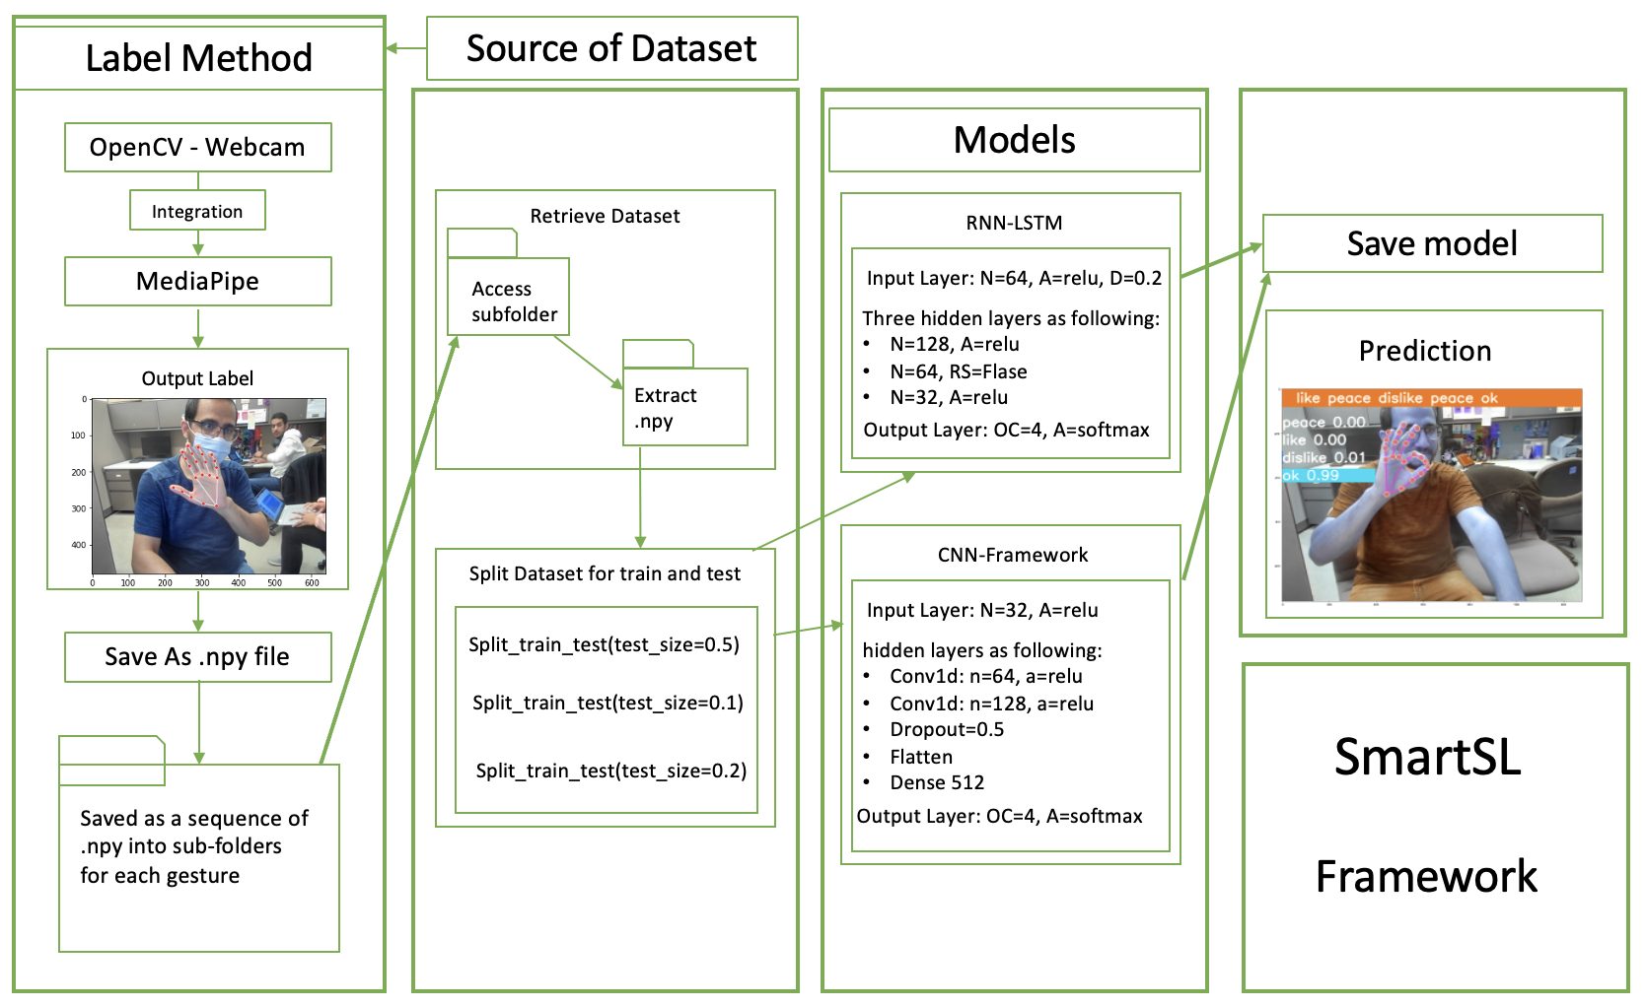
APPROACH FRAMEWORK

Slide 10
APPROACH (CONTD.) SmartSL TOOL
The SmartSL tool encompasses the following.
Graphical User Interface
Web page development done using HTML, CSS and JavaScript
Backend Operations
Created APIs, functions, collection of dataset and training the model using CNN and RNN

Slide 11
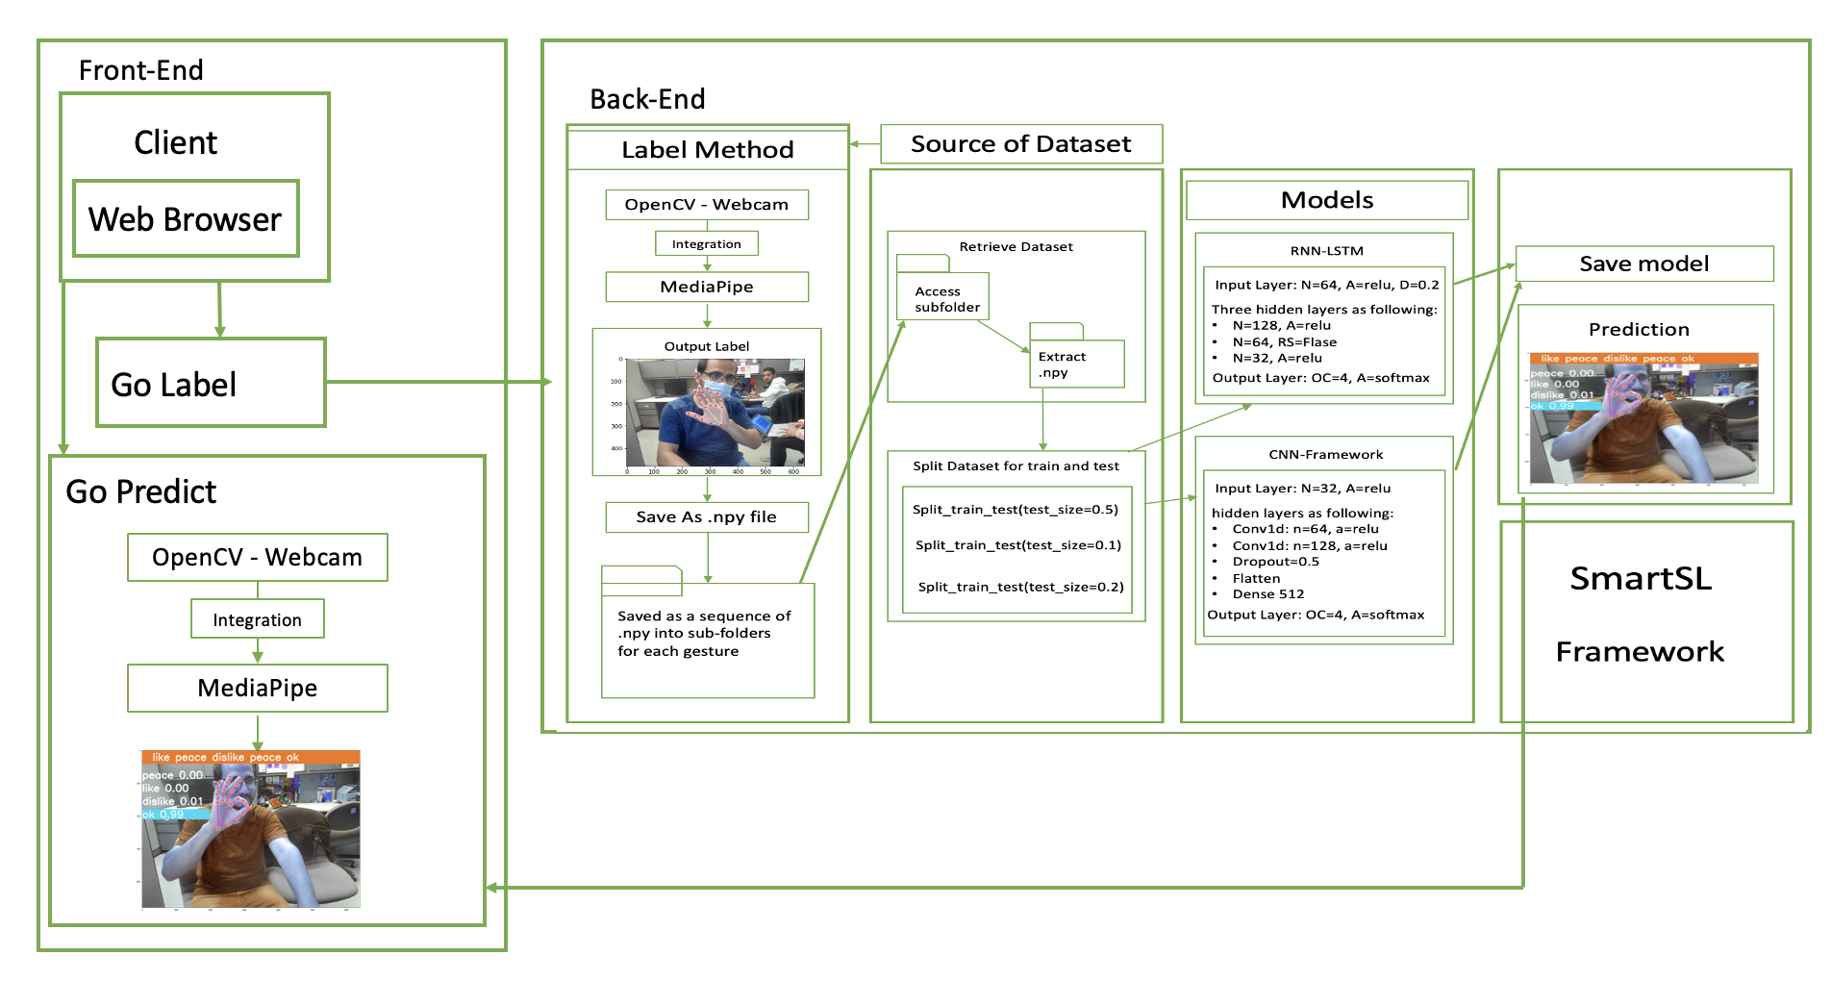

Slide 12

EXPERIMENTATION AND IMPLEMENTATION
Collecting landmarks by MediaPipe as Numpy array
Splitting Train-Test & one-hot encoding
Neural Network models(CNN/RNN)
Train, Save Model and Predict

Slide 13
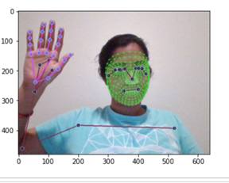
IMPLEMENTATION
Installing and importing dependencies.
Detecting and converting the gestures from BGR to RGB.
Creating methods for capturing key points of landmarks
Setting of media-pipe model for capturing gesture frames.
Setting up path and creating folders for each sequence in gestures.(20 sequences in our case)
Collecting frames for gestures( Ok, Dislike, Like, Peace) and converting to numpy arrays

Slide 14
IMPLEMENTATION(contd.)
Using train_test_split for splitting the dataset to Training and Testing.
Training the dataset using CNN and RNN models for 1500 epochs
Loading the trained model using python-flask and building the web application / tool.
Realtime capture of gestures ,training and predicting them using the tool (after loading the tool on localhost)

Slide 15
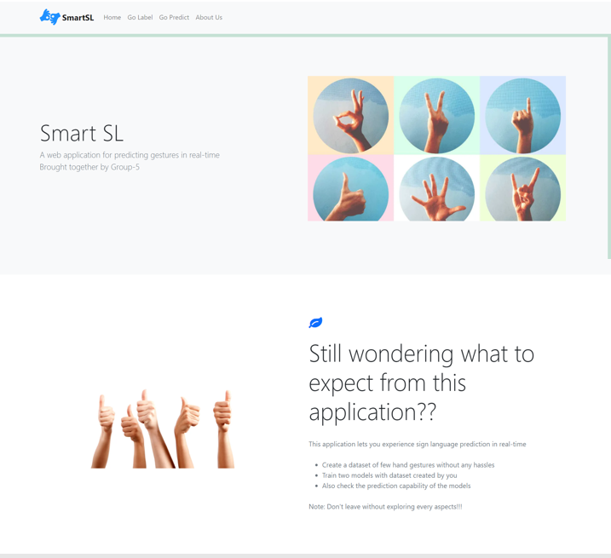

FLOW OF WORKING SMARTSL TOOL
Go Label Page
Training the CNN model with the datasets created
Go Label Page
Creating and Labelling the gestures
Go Predict Page
Testing the model for predicting gestures already created
Go Label Page
Training the RNN model with the datasets created
End users
About Us page
SmartSL Home page

Slide 16
EVALUATION AND RESULTS
The accuracy of our project is the accurate detected gestures in real time.
All the trained gestures have recognized by the model.
The accuracy for each gesture is print it on the screen (Next slide)

Slide 17
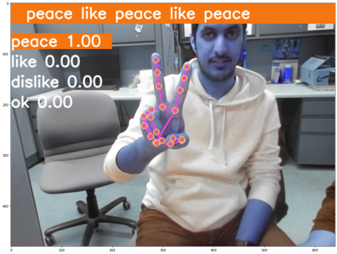
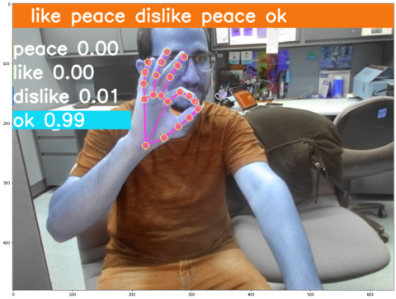
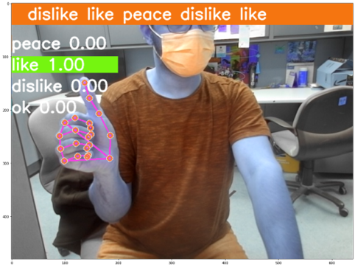
EVALUATION AND RESULTS

Slide 18
CONCLUSION
In this project, we presented an idea for an easier communication between hearing impaired and the normal people.
The SMARTSL tool was developed which gives the end users a chance to capture their gestures, train the model and look at how good or bad the model predicts.

Slide 19
CONTRIBUTIONS
Back End
Ahmed
Front End
Ahmed
Yousef
Chandni
ML / DL
Ahmed
Chandni
Yousef
PPT and Report
Chandni
Aswini
Ahmed
Yousef

Slide 20
Any Questions ?

Slide 21
Thank you

